Slide 1
Research presentation
By Aryan Deorah

Slide 2
Purpose
I want to determine which laws have a positive effect in reducing gun violence
I hope for this information to have some effect on the gun violence epidemic and make some sort of difference

Slide 3
WHY DOES IT MATTER?
The CDC has not been allowed to fund gun control research since 1996
Only private organizations are allowed to do this research
Gun violence has been getting worse in America

Slide 4
Gun violence in America
According to the CDC in 2015, the total number of firearm deaths was 36,252, which was 11.3/100,000 population
This number has steadily increased to 11.8 in 2016
It also varies greatly state to state, from 3.4 in Massachusetts to 23.3 in Alaska

Slide 5
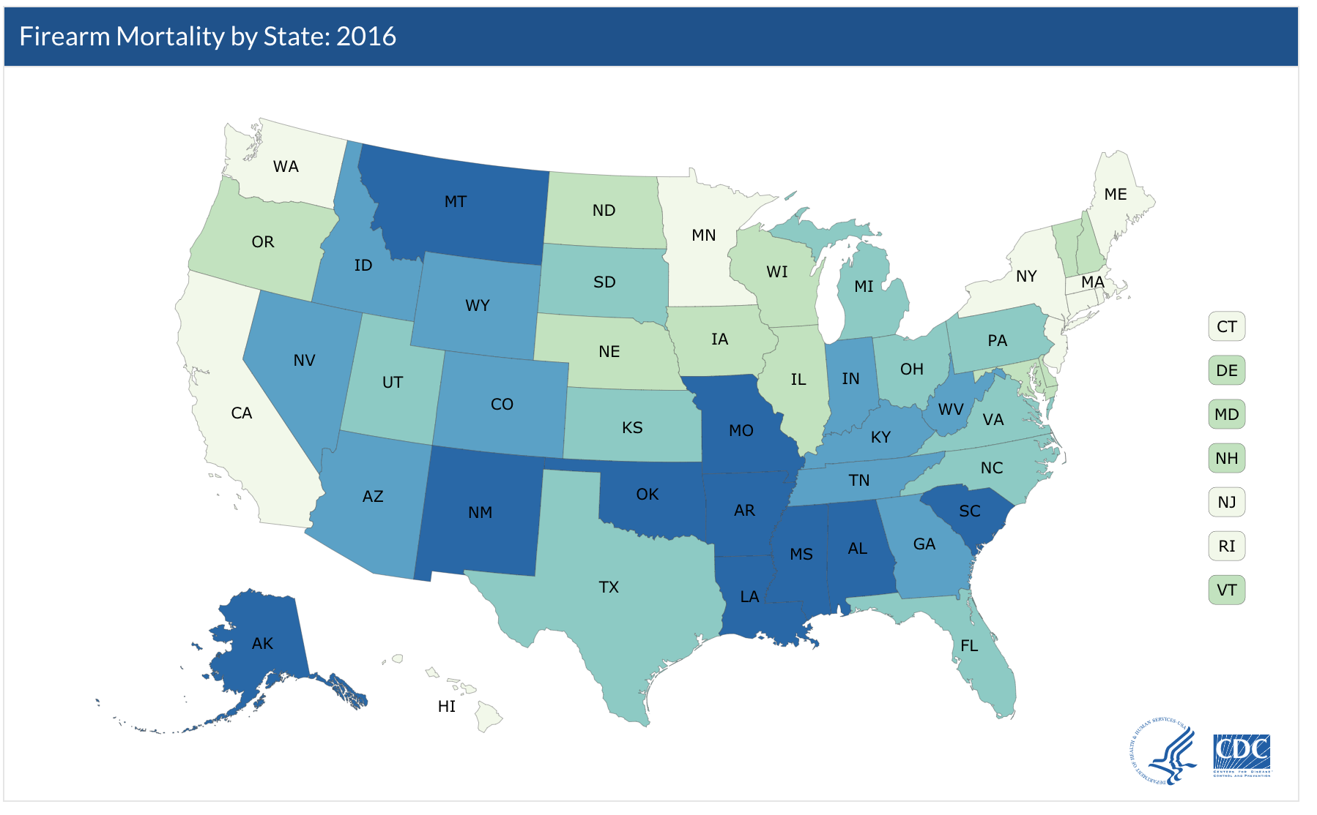
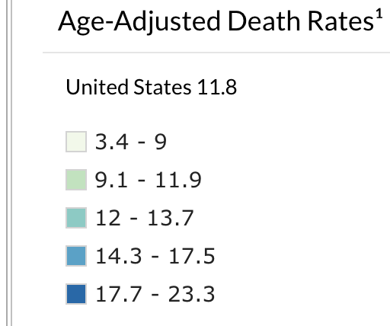
From CDC

Slide 6
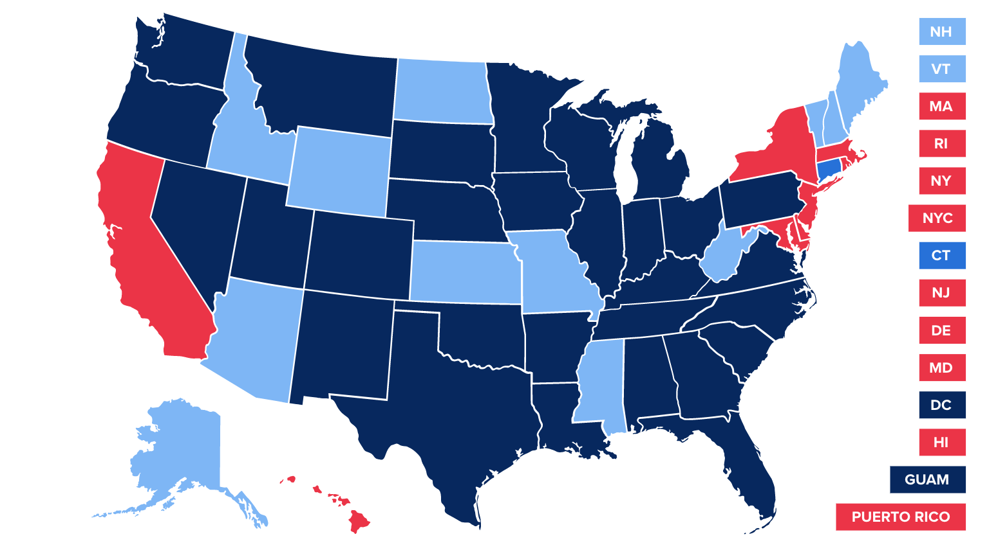
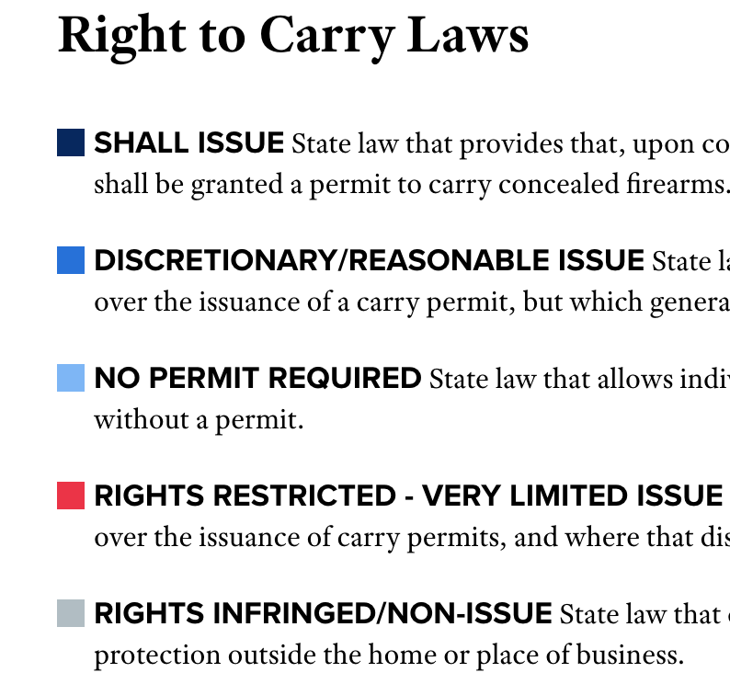
From NRA-ILA

Slide 7
Gun violence in the World
According to a study in the International Journal of Epidemiology, The United States exceeds all High Income and Upper-middle Income nations in the study in gun violence
Regions like North America had nearly 100 fold gun violence rates than Asia
In America, gun violence is half-half suicide, homicide
Different from both HI and UMI nations

Slide 8
Potential laws being looked at
Right to Carry/Concealed Carry Laws
Assault-Rifle and Machine Gun Bans/Restrictions
Mandatory Background Checks
Gun Permit Requirements
Violent Criminal Gun Bans
Mainly state and local laws

Slide 9
How?
I will use data from the CDC and the Uniform Crime Report
I will look at different laws in different municipalities and states
I will first use statistical tests on the data to see which laws can affect gun violence
I will then use machine learning and code kernels such as TensorFlow to get a more complete picture
This will be new because it uses machine learning to model social behaviors. It will also account for other factors and allow me to see how different variables will interact with each other

Slide 10
WorKFlow
Input gun laws as binary matrix
Output is percent influence of law
Input gun violence statistics by category
Run TensorFlow
Train machine with known cases
Repeat training function until accuracy achieved and model defined
Input data into trained machine
Parameters and defined and layers are created

Slide 11
Citations
Gun Laws. (n.d.). Retrieved April 26, 2018, from https://www.nraila.org/gun-laws/?page=537&state=0&startDate=&endDate=&search=&contributor=0&contentBuckets=8180,8176&geo=
Krug, E., Powell, K., & Dahlberg, L. (1998). Firearm-related deaths in the United States and 35 other high- and upper-middle-income countries. International Journal of Epidemiology,27(2), 214-221. doi:10.1093/ije/27.2.214
National Center for Health Statistics. (2017, May 03). Retrieved April 26, 2018, from https://www.cdc.gov/nchs/fastats/injury.htm
National Center for Health Statistics. (2018, January 10). Retrieved April 26, 2018, from https://www.cdc.gov/nchs/pressroom/sosmap/firearm_mortality/firearm.htm
Zhang, S. (2018, February 15). Why Can't the U.S. Treat Gun Violence as a Public-Health Problem? Retrieved April 26, 2018, from https://www.theatlantic.com/health/archive/2018/02/gun-violence-public-health/553430/

